Slide 1

String Manipulation
Python Basics
Cleveland PyLadies
Julie Novic
Jayce Renner
based on
Automate The Boring Stuff
Chapter 6

Slide 2
What is string manipulation?
String manipulation is taking text and doing things to it using code. You can concatenate, format, replace, and remove characters. Text is one of the most common forms of data your programs will handle.

Slide 3
For example
Imagine a program that needs to send customized emails for a shopping website. You could use string manipulation to take a customer’s name and their order details and put them in an email template.
Hello Jayce,
We're excited to tell you that your order L2109339564 shipped on 5/17/22 via FedEx Ground! If you have any questions or concerns, you can reach me at (800) 222-0000
SC4 SC4 TRS to TRRS Adaptor
CMM845 1.5' Euro Patch Cable 8-pk

Slide 4
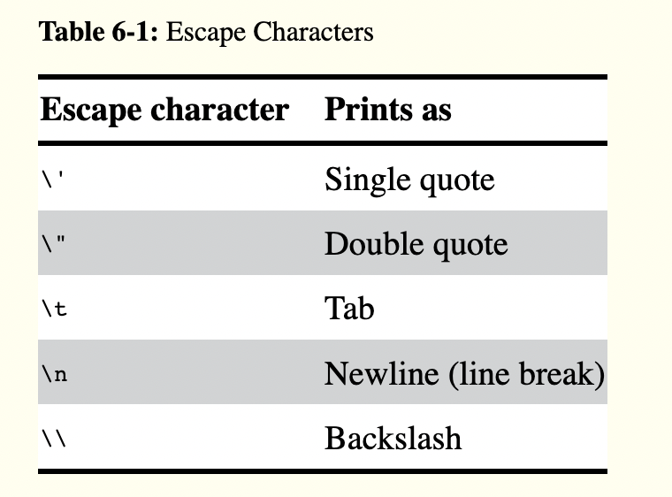
Escape Characters and Raw
Try these statements in your console
a
>>> print('Hello there! How are you? I'm doing fine.')
b
>>> print('Hello there!\nHow are you?\nI\'m doing fine.')
c
>>> print('C:\\File\\Path')
d
>>> print(r'C:\\File\\Path')

Slide 5
Multiline Strings with Triple Quotes
>>> print('''Dear Alice,
Eve's cat has been arrested for catnapping, cat burglary, and extortion.
Sincerely,
Bob''')

Slide 6
Indexing and Slicing Strings
Strings use indexes and slices the same way lists do. You can think of the string 'Hello, world!' as a list and each character in the string as an item with a corresponding index.
' H e l l o , w o r l d ! '
0 1 2 3 4 5 6 7 8 9 10 11 12
a
>>> spam = 'Hello, world!'
b
>>> spam[0]
c
>>> spam[4]
d
>>> spam[0:5]

Slide 7
The in and not in Operators
a
>>> 'Hello' in 'Hello, World'
b
>>> 'HELLO' in 'Hello, World'
c
>>> 'cats' not in 'cats and dogs'
d
>>> spam = 'Hello'
e
>>> spam not in 'Hello, World'

Slide 8
f-Strings
f-strings are a handy way to format strings. Using f-string results in more-readable code compared to ‘ab’ + ‘cd’ syntax. Also, f-strings let you put code statements in curly braces. Statement c works, while statement d fails.
a
>>> name = 'Alice'
b
>>> age = 40
c
>>> f'My name is {name}. Next year I will be {age + 1}.'
d
>>> 'My name is ' + name + '. Next year I will be ' + age + 1 + '.'

Slide 9
.lower() and .upper() Methods
a
>>> spam = 'Hello, world!'
Note that these methods do not change the string itself but return new string values. If you want to change the original string, you have to call upper() or lower() on the string and then assign the new string to the variable where the original was stored.
b
>>> spam = spam.lower()
c
>>> spam
d
>>> spam = spam.upper()
e
>>> spam

Slide 10
.islower() and .isupper() Methods
a
>>> spam = 'Hello, world!'
b
>>> spam.islower()
c
>>> spam.isupper()
d
>>> 'HELLO'.isupper()
e
>>> '12345'.islower()
f
>>> 'abc12345'.islower()
g
>>> 'HELLO'.lower().islower()

Slide 11
.isX() Methods
a
>>> 'hello'.isalpha()
b
>>> '123'.isalpha()
c
>>> 'hello'.isdecimal()
d
>>> '123'.isdecimal()
e
>>> ' '.isspace()
f
>>> 'Stranger Things'.istitle()
g
>>> 'Stranger things'.istitle()

Slide 12
.isdecimal() and Input Validation
Let’s try validating user input in a function. Create or open a file called this_has_functions.py and enter this code and run the program.
1
2
3
4
5
6
7
8
9
10
def ask_age():
print('Enter your age:')
age = input()
if age.isdecimal():
print(f'You are {age} years old.')
else:
print('Please enter a number for your age.')
ask_age()
ask_age()
Note that on line 8, the ask_age() function calls itself. This is called recursion.

Slide 13
.isalnum() and Input Validation
Let’s try validating a password. The password must be alphanumeric -- it can only have letters and numbers. Run the program. Try entering abc@123. What happens?
1
2
3
4
5
6
7
8
9
10
def ask_password():
print('Enter a password with only letters and numbers:')
pw = input()
if pw.isalnum():
print('This is a valid password.')
else:
print('This isn\'t a valid password.')
ask_password()
ask_password()
Note that “isalnum” means “is alphanumeric”

Slide 14
Did you know?
Did you know that computers store text as numbers? Technically, data is stored as different amounts of electricity, which are interpreted as ones and zeros. The ones and zeros are then interpreted as integers. And the integers are interpreted as strings of text!

Slide 15
.split(), .join(), and chr()
Let’s see how characters are stored as numbers! We can write a function!
This website is a handy reference for number/character conversion:
https://www.asciitable.com//
1
2
3
4
5
6
7
8
9
10
11
12
13
14
15
def convert_number_list_to_text():
print('Enter numbers separated by dots:')
input_string = input() # eg 72.105.33
input_list = input_string.split('.')
char_list = []
print(f'List of inputs: {input_list}')
for x in input_list:
if x.isdecimal():
num = int(x)
char = chr(num) # make num a char
char_list.append(char)
output = ''.join(char_list)
print(output)
convert_number_list_to_text()

Slide 16
Summary
String manipulation is important for validating user input and formatting text that your programs need to output. Take advantage of Python’s built-in methods to quickly change text and strings!
Check out Chapter 6 for more ways to handle strings! https://automatetheboringstuff.com/2e/chapter6/

